Slide 1
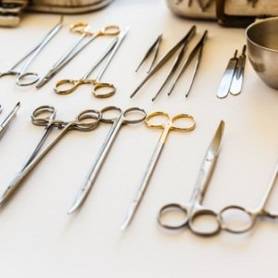
SURGICAL LOAN SETS
THE LEGAL IMPLICATIONS
ANDREA HAYWARD 2019

Slide 2

GOOD MORNING

Slide 3
RESPONSIBILITIES
LOAN SETS
RISKS
ROLE OF SUPPLIER
ROLE OF HOSPITAL
LITIGATION
UNHAPPY PATIENT
NEEDS
CONTRACTS

Slide 4
WHY DO WE LOAN SETS?
Rapid changes in techniques.
Different surgeons require different sets.
Assets are a liability
Costs

Slide 5
ROLE OF SUPPLIER?
Inspect sets before dispatching.
Make sure end users understand their responsibilities.
Ensure that surgeons have been trained in correct handling and management of sets

Slide 6
CSSD staff should be trained. This should be confirmed before CSSD person takes on the responsibility of accepting loan sets.
When loan sets are ordered CSSD must be informed which sets have been ordered.
A loan set checklist must be initiated.

Slide 7
ROLE OF HOSPITAL
Enter details of set in loans control book.
Include date and type of set.
Name of delivery person.
Name of receiving person.
Name of Company, date and time of delivery.

Slide 8
Pack and label set. Remember to add surgeon’s name.
A form with date and time of procedure AND surgeon and assistants’ names.
Training of all staff iro. ordering, checking, reprocessing etc.

Slide 9
Background to the problem
The operating room (OR) is known to be the most cost intensive environment of a hospital.
For various reasons it is also where adverse events are most likely to occur.
Notes:
COST OF EQUIPMENT IS HIGH

Slide 10
Because of the cost factor, the preference of surgeons and individualised needs of patients, the use of loan sets continues to increase .
Introducing loan equipment increases the risk of equipment related adverse effects possibly resulting in litigation.

Slide 11
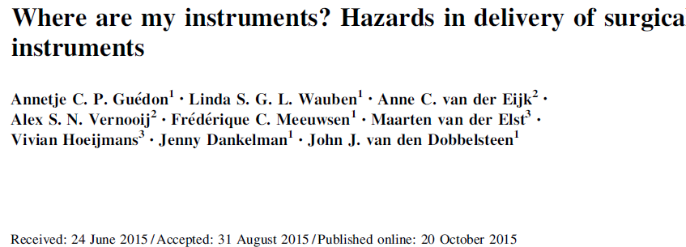

Notes:
In this Dutch article, the authors point out that equip rel incid were observed in nearly 16% of procedures and 40% of the incidents were related to unavailability of instruments.

Slide 12
SURGERY BOOKED:
HIP ARTHROSCOPY

Slide 13
Before Use : CSSD Responsibilities
Loan Sets need to comply with a checklist ensuring the contents are correct.
All documentation is present
Deliver to the Operating Rooms with the tray list and sterilization records.
A loan set should pass through a validated decontamination process prior to use .

Slide 14
During Use : Operating Rooms
All instruments should be checked, counted and documented against hospital list OR count by using the loan set tray list .
If not complete notify surgeon.

Slide 15
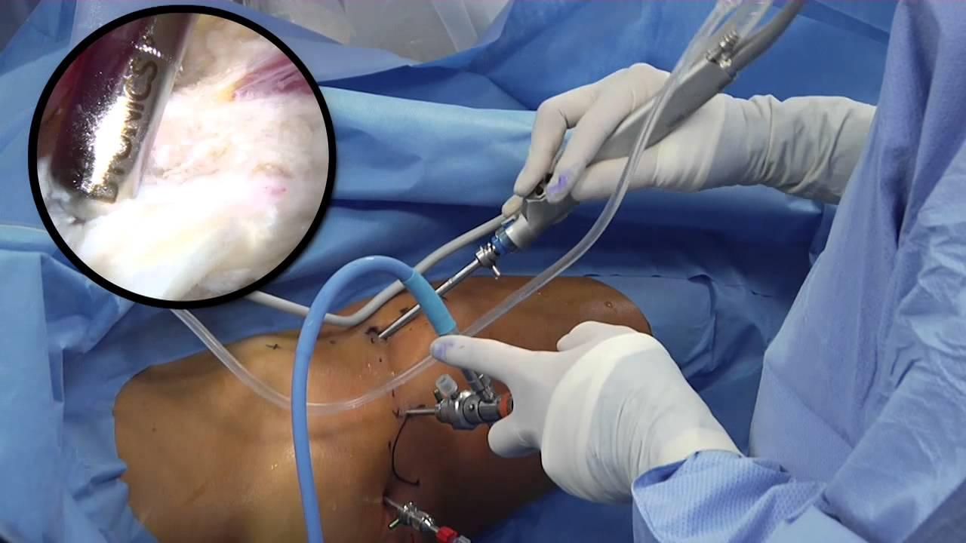

Slide 16
After use CSSD Responsibilities
Package instruments in original containers for return after cleaning and checking.
Notify the company when loan sets are ready for collection
Name of person collecting
Name of CSSD personnel handing over the loan set.
Date and time of collection
Wipe loan set from the board/book.

Slide 17

RESPONSIBILITIES
LOAN SETS
RISKS
ROLE OF SUPPLIER
ROLE OF HOSPITAL
LITIGATION
UNHAPPY PATIENT
NEEDS
CONTRACTS

Slide 18
ROLE PLAYERS IN MEDICAL LITIGATION
AVOCATE High Court
ATTORNEYS
EXPERTS Surgeons
            Nurse
            Commercial Supplier
            Physiotherapist
            Occupational therapist
            Actuaries

Slide 19
ROLE PLAYERS IN MEDICAL LITIGATION
Plaintiff Patient (or family)
Defendant 1 Doctor
Defendant 2 Hospital

Slide 20
LITIGATION
Ms Allfal Down works at a supermarket.
Whilst stocking the shelves after the shop has closed, she falls and injures her ankle.
On the way home she visits the emergency rooms at the local hospital where she is seen by a doctor who straps her foot and sends her home with Panado for pain.
The next day, 25/5/16, the pain worsens. She returns to the hospital and is seen by Dr W Dunitt, an orthopaedic surgeon.
Notes:
Because Orthopaedic cases are the most common, I have used examples from that discipline.

Slide 21
Dr Dunitt will admit Ms Down for an ankle arthroscopy and tells her about the surgical procedure that he will carry out.
She arrives at 06:30 on 26/5/2016 as instructed.
She went to theatre at about 10:00.
When Dr Dunitt does his post surgery rounds he tells Ms Down that the procedure has been successful and he will return later to discharge her.

Slide 22
On discharge he tells the patient that due to the unavailability of the required equipment he was unable to carry out the surgery however he has given her a cortisone injection for the pain and swelling. He explains that she should come back for removal of the stitches in a week

Slide 23
When Ms Down returns for suture removal she expresses her unhappiness and wants an explanation for having an anaesthetic but no operation. She also wants to know why she has stitches if there was no operation.

Slide 24
Dr Dunitt explains that the staff did not have the loan set as requested. She should not be concerned. She probably doesn’t need the surgery now anyway. He has asked the hospital management to investigate.

Slide 25
She explains that this is a COID claim (WCA) and on her discharge form it states that she had an Arthroscopy and that is now incorrect. Where does that leave her?
Ms Down is unhappy and seeks legal advice.
Dr Dunitt is charged with misconduct.
An investigation regarding the loan sets is undertaken.

Slide 26
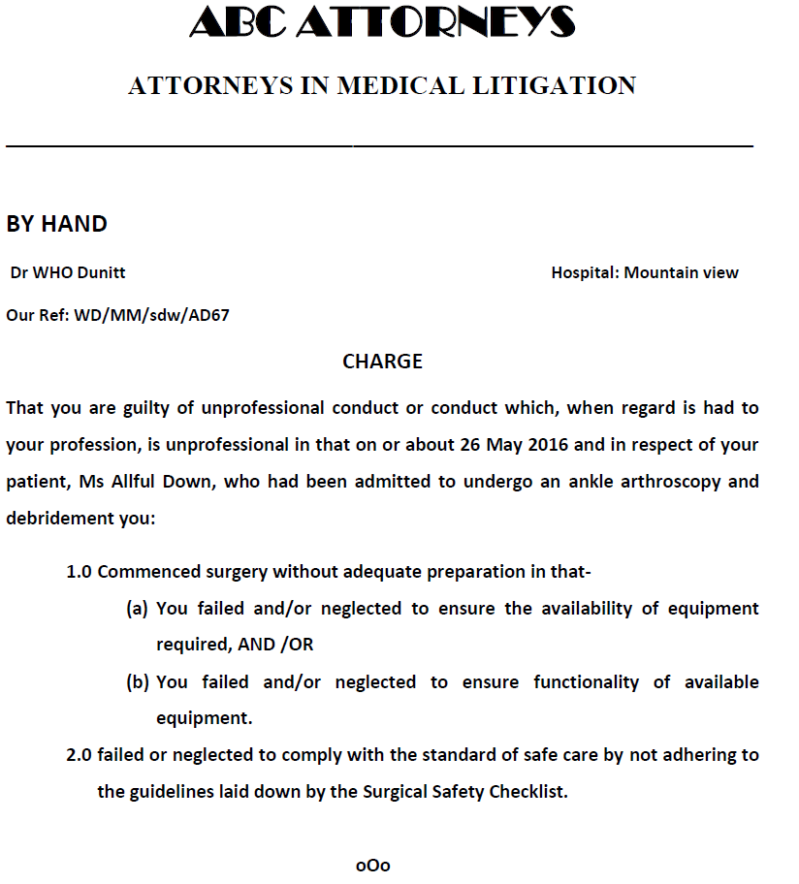
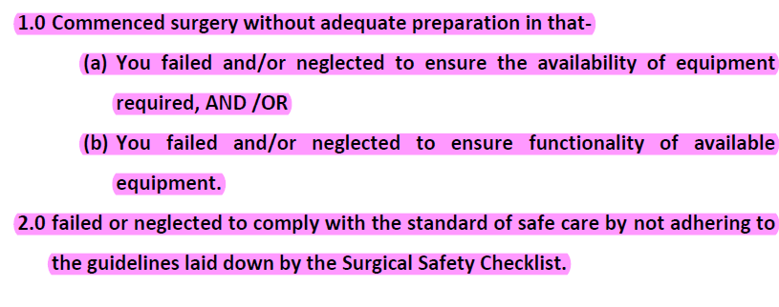

Slide 27
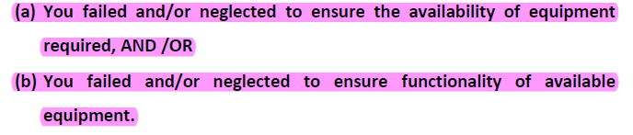

Slide 28
COMPANY A DELIVERY NOTE
Number: 60224 Invoice: 1111.6286
Delivery details: Hospital Mountainview Clinic
Procedure date: 26/05/2016 Time: 1030
Surgical sets: Endo - small joint Joint shaver
Doctor: Dr Who Dunnitt.
Order Information
Date: 24/05/2016 Ordered by: Mr Crow (Clin Tech)
Contact number 27 19 506 6237 Patient : Ms Allfal Down
Checked by :C Reps_ Print name C Reps Date:24/5/2016 Time 1730
Received by: Sarah Print name_Sarah__Date:24/5/2016 Time 1730
Serial number Description Quantity
103327 SMALL JOINT INSTRUMENT SET 1
671824 SMALL JOINT POWER MINI SHAVER 1
Returned Date: 26/05/2016 (15:00) Quantity
Serial Number 1

Slide 29
COMPANY A DELIVERY NOTE
Number: 60224 Invoice: 1111.6286
Delivery details: Hospital Mountainview Clinic
Procedure date: 26/05/2016 Time: 1030
Surgical sets: Endo - small joint Joint shaver
Doctor: Dr Who Dunnitt.
Order Information
Date: 24/05/2016 Ordered by: Mr Crow (Clin Tech)
Contact number 27 19 506 6237 Patient : Ms Allfal Down
Checked by :C Reps_ Print name C Reps Date:24/5/2016 Time 1730
Received by: Sarah Print name_Sarah__Date:24/5/2016 Time 1730
Serial number Description Quantity
103327 SMALL JOINT INSTRUMENT SET 1
671824 SMALL JOINT POWER MINI SHAVER 1
Returned Date: 26/05/2016 (15:00) Quantity
Serial Number 1

Slide 30
PERIOPERATIVE FORM
Patient Name: Ms A Down
Operation: Ankle Arthroscopy and debridement. Date: 26/5/2016
Surgeon: Dr W Dunitt Anaethetist: Dr Snooze
Scrub Nurse: A Crow (Clin tech) Floor Nurse: B Smart E/N
Time in: 1035 Time out: 1100
Swab count: Correct Instrument count: Correct
Loan sets: Checked / Correct
Registered Nurse: Anaesthetic Nurse:

Slide 31
RECOVERY ROOM
Patient Name: Ms A Down
Operation: Ankle Arthroscopy and debridement. Date: 26/5/2016
Surgeon: Dr W Dunitt Anaethetist: Dr Snooze
Signature.................. Signature.......................
Recovery room nurse ...........................
Time in: 1105 Time out: 1120
Awake and vitals stable. Return to ward.

Slide 33
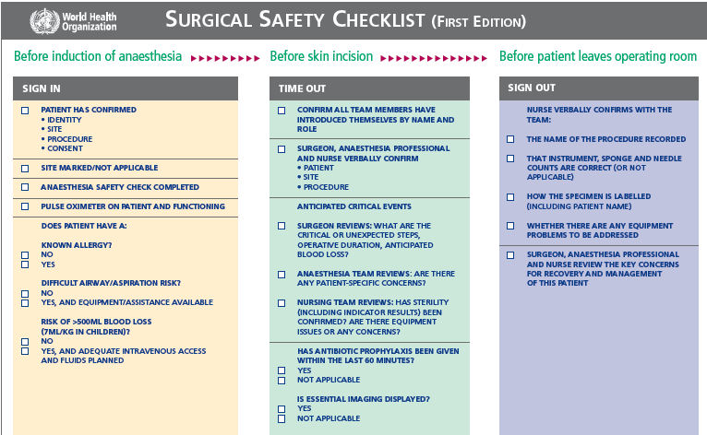

Slide 34
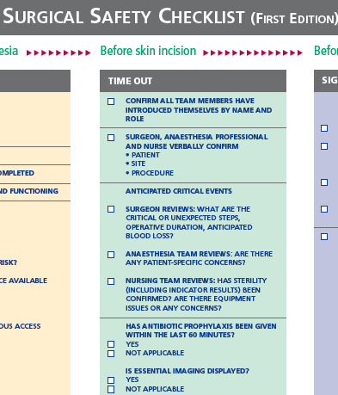
WORLD HEALTH ORGANISATION

Slide 35
SO WHO IS GUILTY?
Is the doctor guilty of poor conduct?
Does anyone else share guilt?

Slide 36
COST OF LITIGATION
UPDATED 17 APRIL 2018
Medical malpractice litigation: Undermining South Africa’s health system
South Africans are becoming increasingly litigious, with not only the number of claims rising but also the size of the claims.
.
"explosion" by previous Health Minister, Dr Aaron Motsoaledi,
was reported that Gauteng Health Department alone had paid out at least R1 billion in lawsuits since January 2015, while the Eastern Cape is facing payouts of R14 billion.
The Medical Protection Society SA (MPS), in 2015 settled a claim of almost R24 million on behalf of a member

Slide 37
CLOSING COMMENTS
Procedures & checks in place but not adhered to.
Tracking system is NB.
How many boxes in loan set.
Do scrub staff know how it works?
If we dont adhere ....... what then?
Pt didnt understand op. Would always be a wound with a stitch

Slide 38
REFERENCES
CSSD Forums of South Africa Decontamination and Sterilisation. Standard Operating Procedures 2018.
Habraken MM, Van der Schaaf TW, Leistikow IP, Reijnders-Thijssen PM (2009). Prospective risk analysis of health care processes: a systematic evaluation of the use of HFMEA in Dutch health care. Ergonomics 52:809–819.
Annetje C. P. Gue´don; Linda S. G. L. Wauben; Anne C. van der Eijk; Alex S. N. Vernooij; Frederique C. Meeuwsen; Maarten van der Elst;
Vivian Hoeijmans; Jenny Dankelman; John J. van den Dobbelsteen.
Where are my instruments? Hazards in delivery of surgical
instruments. Surg Endosc (2016) 30:2728–2735
SAMED Device Code of Ethical Marketing and Business Practice. (2018) 7-15

Slide 39
