Slide 1
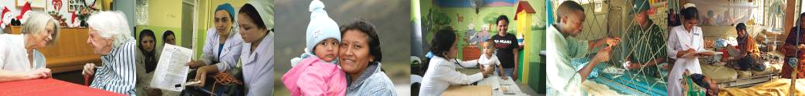
World Health Organization view of Quality in Africa
Dr Nino Dal Dayanghirang
Service Delivery, Quality and Safety in WHO/AFRO
Quality Management Conference, May 2019, South Africa

Slide 2
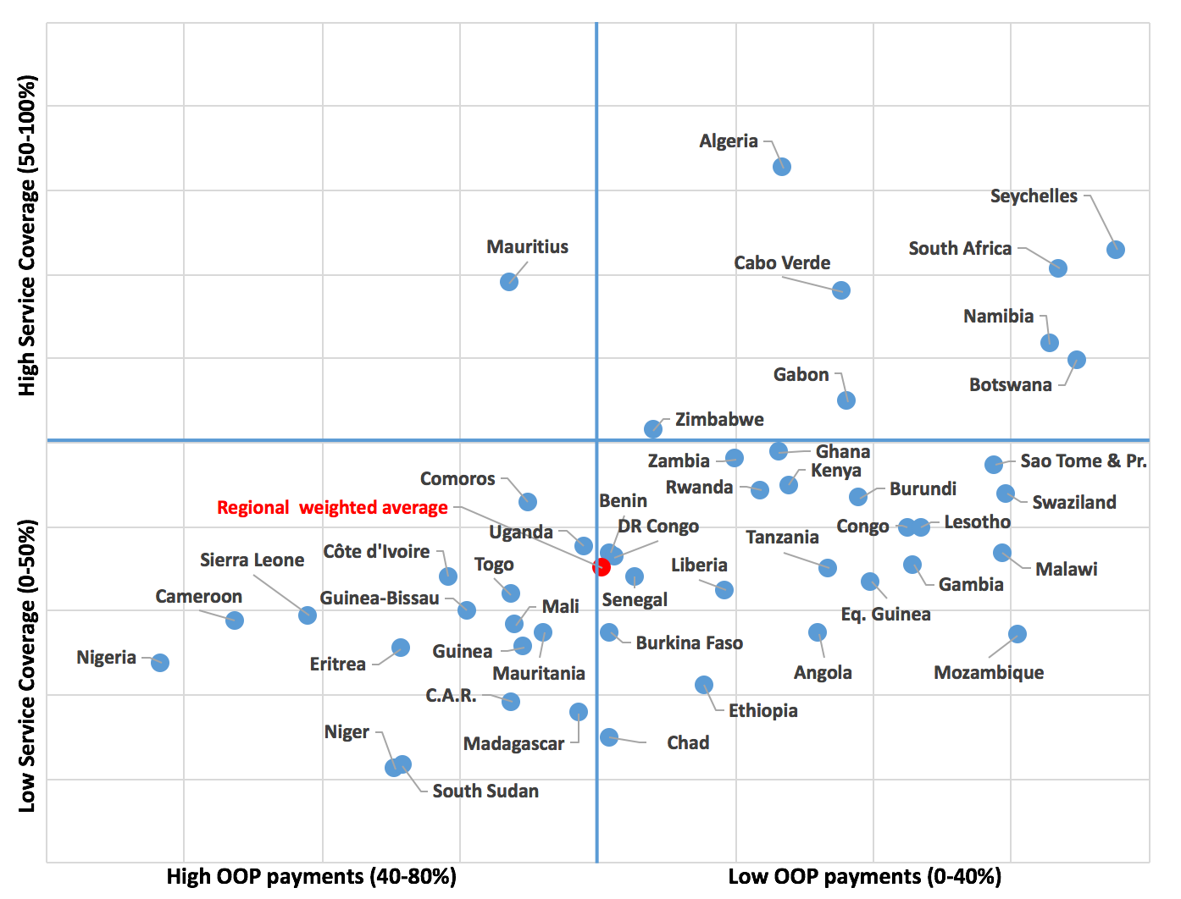
CONTEXT & BASELINE TO UHC:(Global Health Observatory 2015) Service Coverage index & “Out of Pocket expenses”

Slide 3
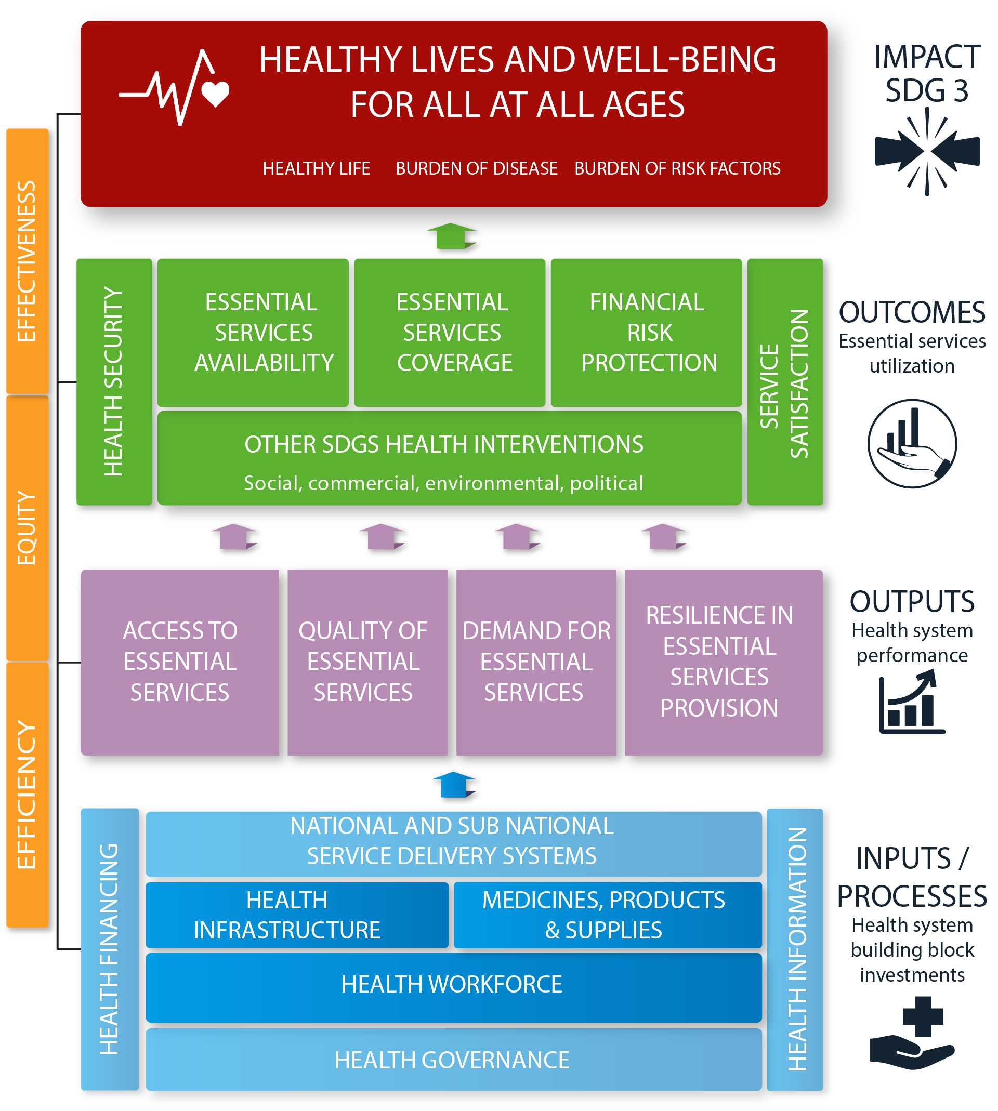
FRAMEWORK OF ACTIONS
Single interlinked logical framework to integrate systems and services for attainment of SDG 3 goal
Domain areas (4); and dimensions (20) defined around which attributes defined as menu of options for actions
  Impact: Healthy life, BoD and BoRFs – measured by efficiency, effectiveness and equity
  Outcome: Health and related results people desire – including UHC dimensions
  Output: System performance dimensions
  Inputs/processes: Building blocks for investment
Integrated guidance to countries on achieving UHC and other health related SDGs

Slide 4
Overall Expected Outputs/Results
Improved systems resilience/IHR core capacity
Improved quality & client satisfaction indicators
Improved Health Systems “input” indicators
Improved access/UHC for Adolescents (*Flagship)
Improved UHC output & outcomes indicators (framework)
10% annual reduction in % of OOP in THE over (SDG) period with increased coverage of underserved populations
Increased % of identified vulnerable populations with access to Essential Package (EPHS)
Increased % of domestic resources in THE (*MICs & HICs)

Slide 5
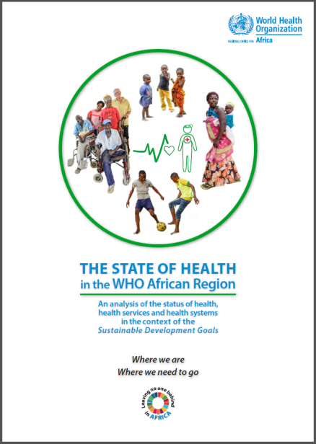
THE STATE OF HEALTH in the WHO African Region
Quality of care is a difficult dimension of performance to measure.
WHO/AFRO Framework of actions characterizes three important attributes of quality, all related to the care process:
  client perceptions of the care process based on their experiences,
  level of safety (no harm done) during the care process; and
  the eventual effectiveness of care provided.

Slide 6
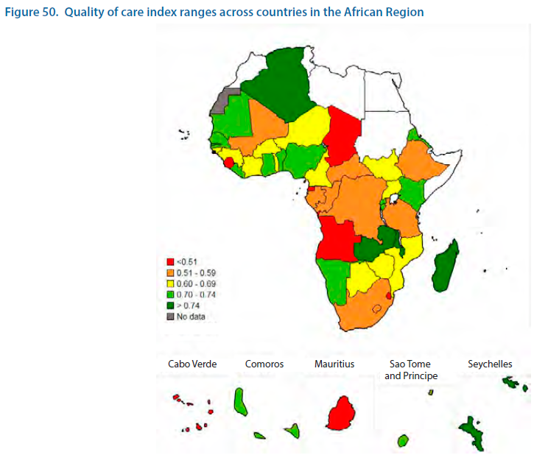

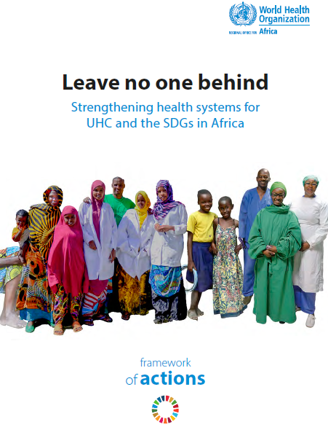

Slide 7
WHO/AFRO/SDS/SQS activities 2019
Universal Health Coverage Flagship – development of roadmaps (which includes quality and safety)
Infection Prevention and Control (IPC) Survey in all countries (January – July 2019)
  As of 14March2019 the following countries have submitted some information: Algeria, Cameroon, Congo, DRC, Cote d’Ivoire, Ghana, Kenya, Liberia, Nigeria, Senegal and South Africa
  Annual Hand Hygiene Campaign: Clean care for all – it’s in your hands
  Minimum Standards for IPC
Capacity Building in 10+ Anglophone countries (August 2019, Zimbabwe)
African Regional Launch of the 3rd WHO Global Patient Safety Challenge: Medication without Harm (October 2019, South Africa) including African Patient Safety Initiative

Slide 8
2019 planned but no funding
Situational analysis of quality and safety in 10 Central African Countries, all Eastern/Southern African countries
Support countries to review/adapt and implement guidance quality and safety in Burkina Faso, Eritrea, Kenya, Lesotho, Liberia, Malawi, Sierra Leone, South Africa
Defining norms and standards including accreditation in Burundi, Gabon, and Congo

Slide 9
13th General Programme of Work 1.1.1
46 out of 47 countries prioritized 1.1.1 – countries enabled to provide high quality, people-centred health services, based on primary health care strategies and comprehensive essential service packages
  Alignment of the country support with the defined country UHC roadmaps (UHC flagship)
Sharing the learnings of the QOC network (http://qualityofcarenetwork.org/) to other clusters programmes (CDS, NCD, WHE)
  Special focus on Small Islands Developing States (SIDS)
Regional Committee document on quality and safety (including AMR, IPC and WASH)

Slide 10
Some global goods on quality and safety
Flexible support package for countries
  Quality Toolkit
  Resilience Toolkit
  Community Engagement for quality people centred & resilient services
Global Learning Laboratory for Quality UHC
Global Patient Safety Network
Global Patient Safety Collaborative
Global IPC Network
Digital health (quality and safety including IPC)

Slide 11
Some of the partners (not including MOH)
Partners in Health and Netcare (South Africa) – 3rd Global Patient Safety Challenge
ISQua / COHSASA – African Community of Practice
Robert Koch Institute, African Union and Infection Control Africa Network – Infection Prevention and Control
University of Lagos and Obafemi Awolowo University / Teaching Hospital – potential WHO collaborating centres
WHO/EMRO – Patient Friendly Hospitals
WHO/AFRO/FRH – Quality Network
WHO/WASH – Healthcare Facilities

Slide 12
Quick actions for quality, safety and IPC in WHO/AFRO
Send us an email regarding your activities and countries you are supporting
Join (social media?) the upcoming regional campaigns on UHC (#HealthForAll), infection prevention and control (#HandHygiene), world patient safety day (17 September 2019), patient solidarity day (December 2019), World Antibiotic Awareness Week 2019.
Join the ongoing IPC survey
Be recognized as a WHO/AFRO partner participating in the 3rd WHO Global Patient Safety Challenge on Medication Safety
Join/present on the upcoming monthly ISQua / WHO / COHSASA Community of Practice for Africa (AfCOP)

Slide 13

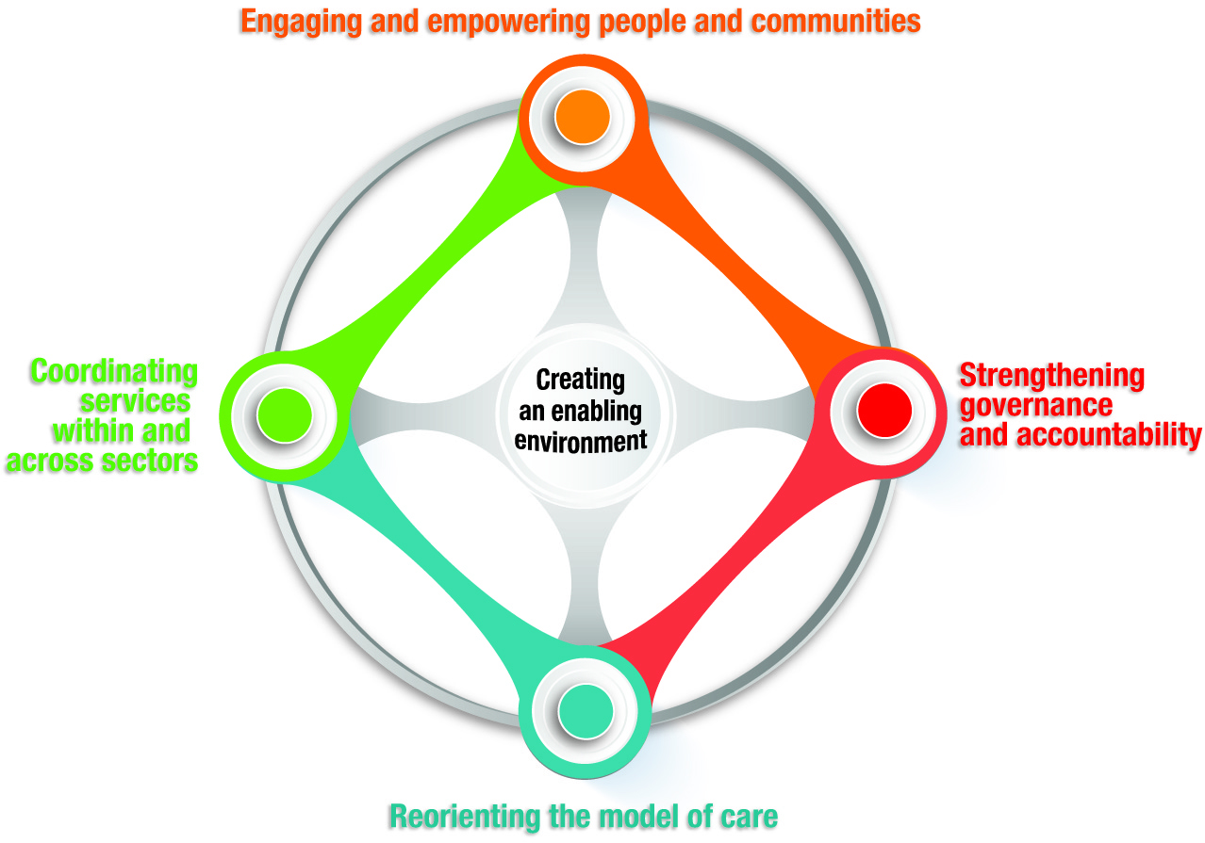

WHO recommends five strategies
Notes:
Country status
Low-income: increase providers awareness on the multidimensional and complex nature of health; community involvement in policy decisions; increasing health coverage through PHC; better integration of care between disease-specific prevention and treatment programmes (co-locate care and treatment in PHC); aim is to provide more holistic and accessible care to people who may be living with more than one long term condition (e.g. HIV and TB)
Middle-income: strengthening PHC and community care most common (expanding their roles to be “health living centres” that enable a wider range of services sto be made available to local people); prevention and control in the rise in chronic disease (new laws, regulations – tobacco control); engaging and empowering people to adopt healthy lifestyles
High-income: structural and financial reforms to promote integrated care; intersectoral action with social services (housing, employment, welfare, etc.); enabling people to manage their own health conditions through self-care; better coordination of care between settings, especially in transitions from hospital to home.

Slide 14

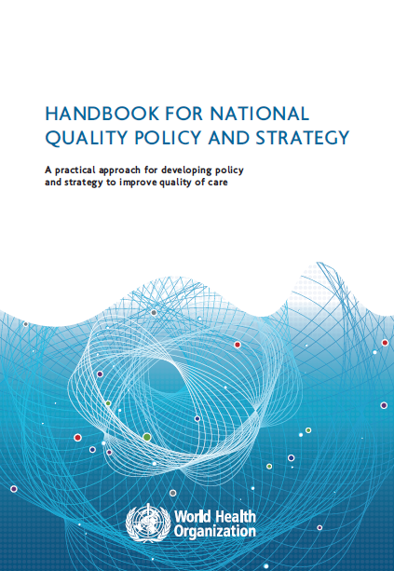
Dr Nino Dal Dayanghirang
DayanghirangND@WHO.int
@ninodal2013

